Slide 1

I Just Want to Restore a Cube…
Tsinghua CST62 Lu Rui
2016011255

Slide 2

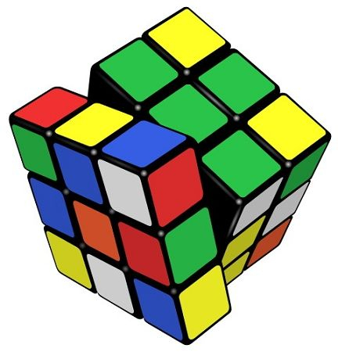
Many days after I finished the big project of restoring cube, I still remember the evening
when my program failed the #9932 nd test out of 10000 random data at the last night of ddl.

Slide 3
What am I going to talk about?
1. Some simple tricks that facilitates restoring cube.
2. Share some f**king bugs I had come across and lesson I was taught by them.
3. My understanding and belief of “high cohesion & low coupling”

Slide 4

Section 1: How to operate cube elegantly?
At beginning, I ,together with my partner, chose a quite straightforward way to record and operate cube.

Slide 5
Section 1: How to operate cube elegantly?
But problem arise very soon.
What is that?
Too complicated to implement the basic operation R, U and z!
How to solve the problem?

Slide 6

Let your partner do that!~~~

Slide 7
But I’m not going to introduce how he made it.
Because even though he successfully implement these operations after two whole days, I found it almost impossible to go on programming.
You can imagine how many lines of code it takes to find a certain sub-cube(like green-white) and make operations in this kind of structure. (120+)
WHY?

Slide 8
Trouble deserved
The main reason for this kind of trouble is clear
It originated from the way of recording the cube we decided at the very beginning
It lacks symmetry! We chose the wrong object!

Slide 9
EVENTUALLY
Realizing that the object we need to handle is actually sub-cube but not faces.
Employ a method that treat every sub-cube (edge or corner) absolutely equally.
Take advantage of base 6.

Slide 10
Brief introduction of recording a sub-cube
///face 0 1 2 3 4 5 is bottom, front, right, back, left, top
/// color 0 1 2 3 4 5 means green, white, red, yellow, orange, blue
int corner[6][6][6];
//corner[color1][color2][color3] in base 6 is (abc)6. a, b and c stands for the face color1, 2, 3 is facing.
Int edge[6][6];
//edge[color1][color2] = (ab)6, color1 at the face a while color2 at the face b.
Each edge sub-cube will be recorded in different direction TWICE!
Each corner sub-cube for SIX times! SIX TIMES!!!(in all permutation)

Slide 11
But this just remove(or accumulate)the trouble
Before I cast the screenshot of code, I would like to say more about why I use this way to record cube.
The normal process of restoring can be concluded into 3 steps
1. Find certain sub-cube/scan current pattern
2. Lock the case
3. Make correspondent operation
finding the sub-cube red-green-white, we can simple take t = corner[2][0][1], t % 6 is white’s face, t/36 is red’s face

Slide 12
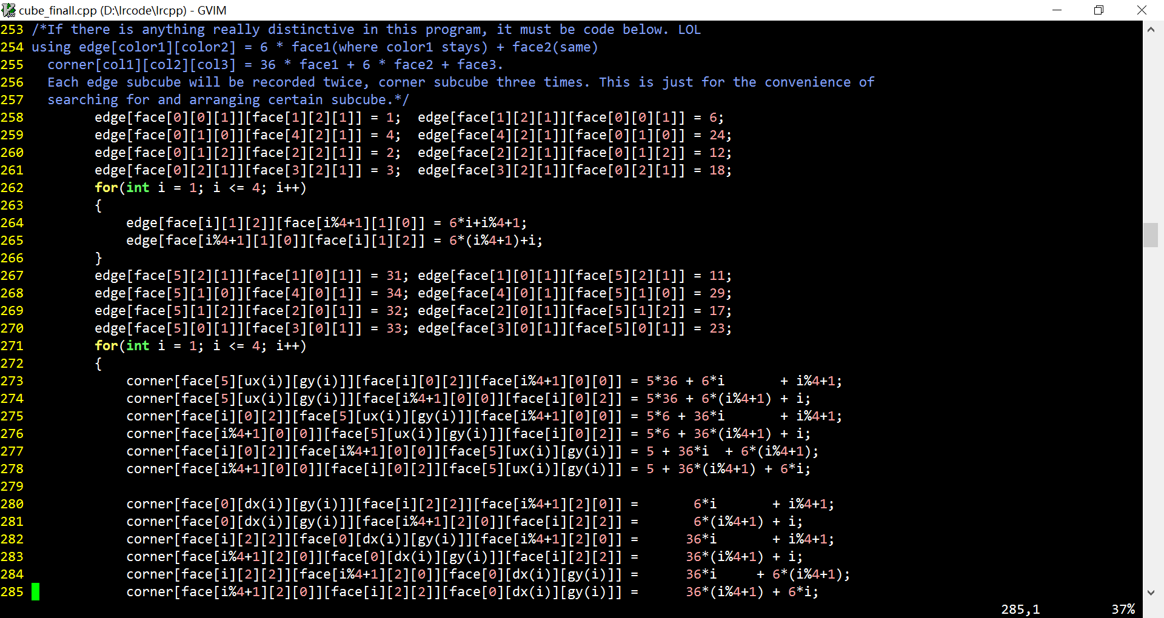
前方高能 Attention! High Energy!

Slide 13
What’s more, the operations of turning cube become elegant.
For instance, if you want to make U(), in fact what you want to do is changing the cube’s position as below:
Bottom front right back left up //before
Bottom left front right back up //after
Using the language of group theory(rename rule), we may say
X : 0, 1, 2, 3, 4, 5
Φ(X) : 0, 4, 1, 2, 3, 5

Slide 14
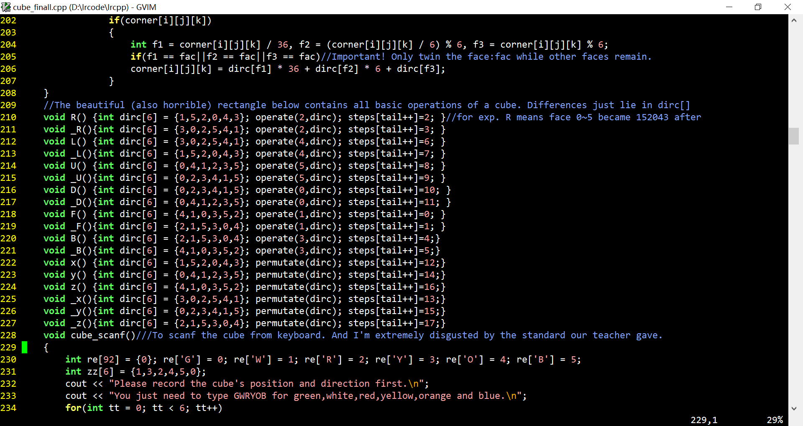
So we just need to change all the x to φ(x)! Code as below

Slide 15
Section 2: Forever struggle against BUG
Before you could marvel at this massive code, I have to admit that…
Among this screen of code exist two BUGs that cost me several weeks to find them.

Slide 16
Bloody Lesson
Consider the structure and the implement before you construct the object and the class.
Symmetry and a robust handling system(equally treating cases) is important
MATH helps a lot. (x

Slide 17
High cohesion & Low coupling
I still remember when TA gave out his standard input/output format, many classmates were driven to mad.
Because their program relied too much on the input format and the relative relationship of colors.(Like hardcoding: red is opposite to orange…)
This is called of “high coupling”, means a program that is too rigid, relies too much on other part and lacks flexibility.
On the opposite, an basic implement function should be highly cohesive and robust, this is called high cohesion.

Slide 18
Thank you!

